Slide 1
Philip Bouverat
Rural Development and Wealth Creation

Slide 2
A New Generation
“JCB remains a family business”
Lord Bamford Chairman, JCB Group
Notes:
2
JCB is almost unique in this industry in that it remains privately-owned and family run, allowing JCB to maintain its focus on core principles.
Today’s chairman, Sir Anthony Bamford, is the eldest son of Mr JCB, born in 1945, the year that JCB was founded.
He became Chairman of JCB when he was just 29, although he had grown up steeped in the business and, apart from a stint with Massey Ferguson in France, he has been actively involved in the company since 1964.

Slide 3
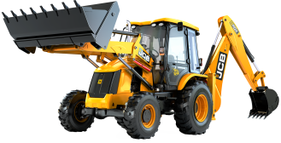
1 out of every 2 is a JCB
Notes:
Sir Anthony has continued his father’s legacy by bringing innovative products to market
But he has also transformed the company into a global business, with a broadened product portfolio; manufactured and sold around the world.
Approximately two decades before others, Sir Anthony recognised the potential of the Indian market and set up manufacturing operations there in 1979. This foresight has led to India becoming JCB’s largest single market, where it has a 75% share of the Backhoe Loader market.
And it’s not just India. Sales subsidiaries have been established across Europe in order to maintain JCB’s position as Europe’s number one.
And he has overseen the ascendancy of both the JCB Backhoe Loader and the Loadall to become the worldwide bestselling products in their categories – in fact one in two backhoes sold around the world today is a JCB.

Slide 4
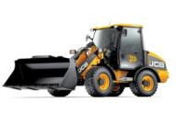
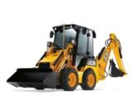
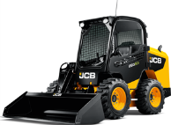
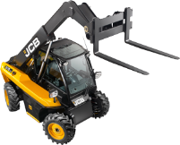
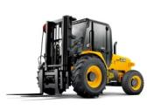
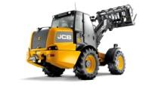
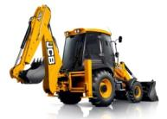
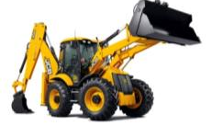
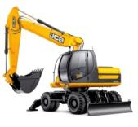
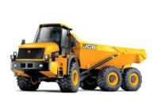
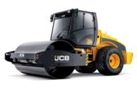
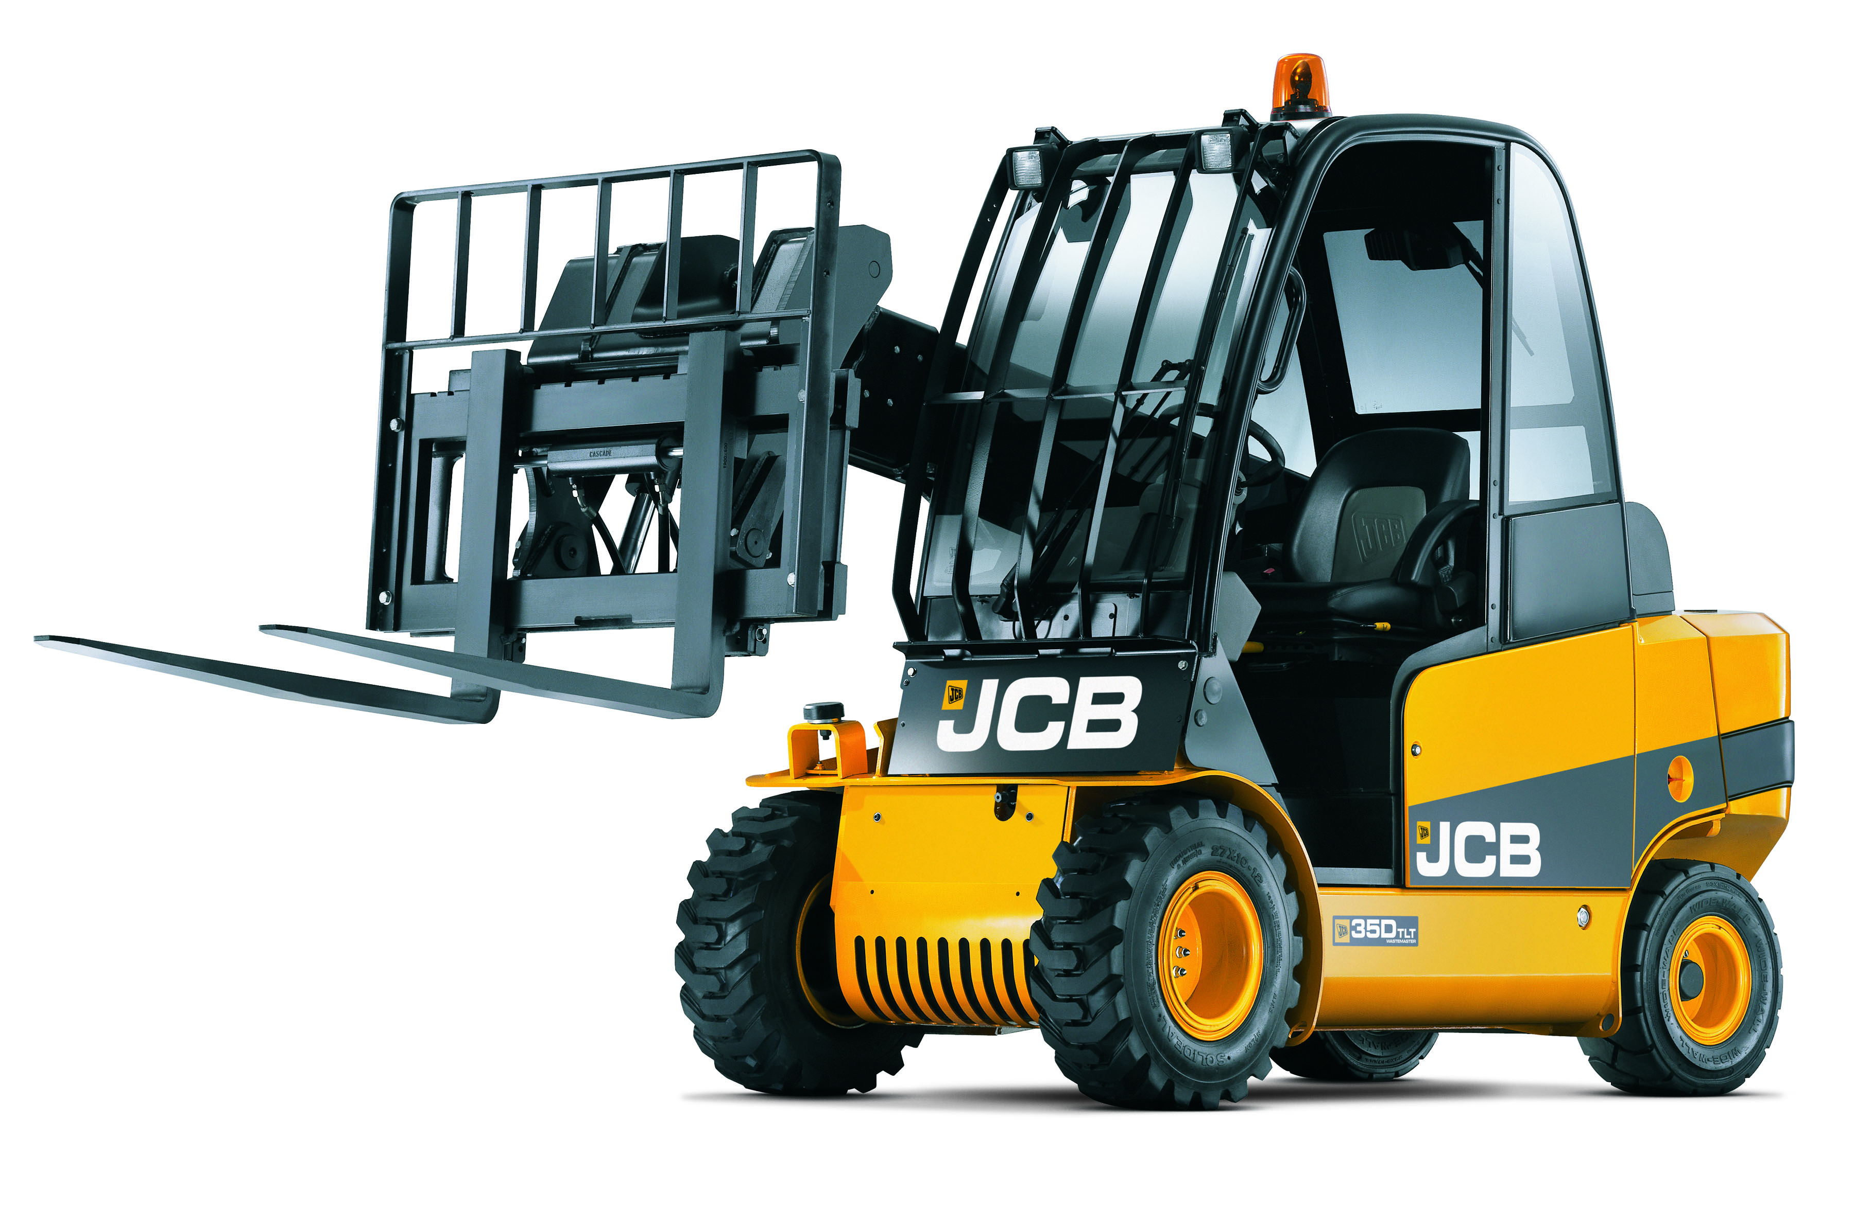
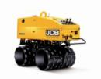
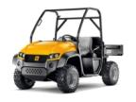
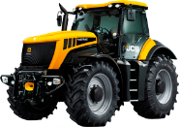
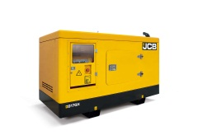
Full range manufacturer
300 MODELS
Compact
Mid Range
Heavy Line
Other
Notes:
This is JCB!
A business that today manufactures over 300 products – ranging from compact products, that include mini-excavators and skid steer loaders – through to mid-range machines, that include the iconic backhoe loader, together with the industry-leading telescopic handler.
We also make heavy-duty equipment – tracked and wheeled excavators, articulated dump trucks and wheeled loading shovels.
And the range is completed with the innovative Fastrac tractors, gensets, UTVs and diesel engines to name but a few of our products.
4

Slide 5
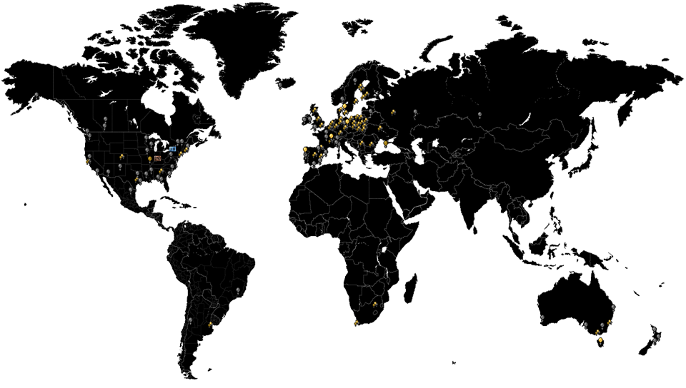
One of World’s Leading Brands
22 Plants . Presence in 150+ Countries

Slide 6
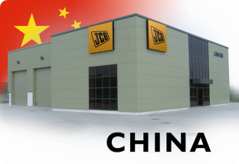
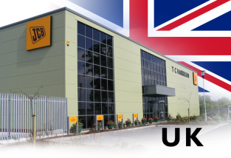
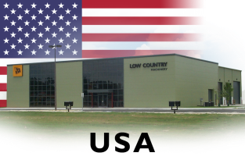
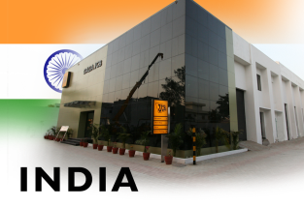
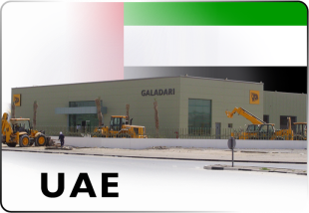
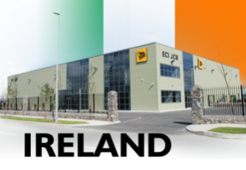
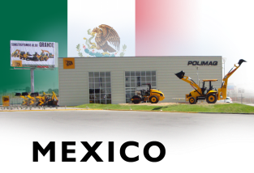
Global network of dealers
750 Dealers Worldwide
2,000 Dealer Depots Worldwide
Best Back-up In Business
Notes:
6
We have the best set of dealers in the industry bar none.
As Sir Anthony said, some of them have been with us for generations and know our business as well as we do.
But increasingly we have sought out the best partners in new and emerging markets, giving us a global network of some 750 dealers, operating out of more than 2,000 depots.

Slide 7
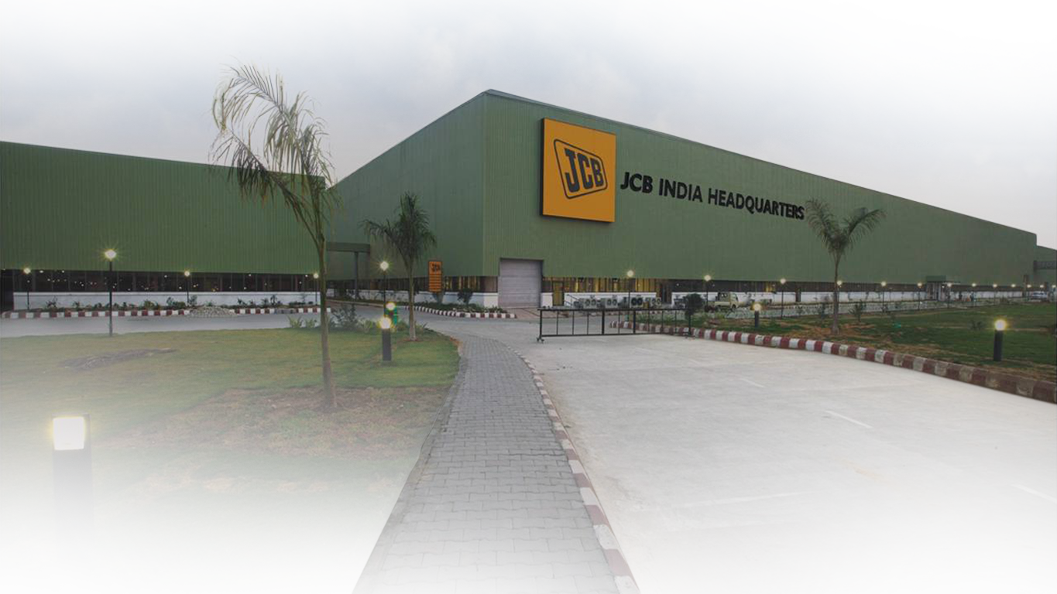
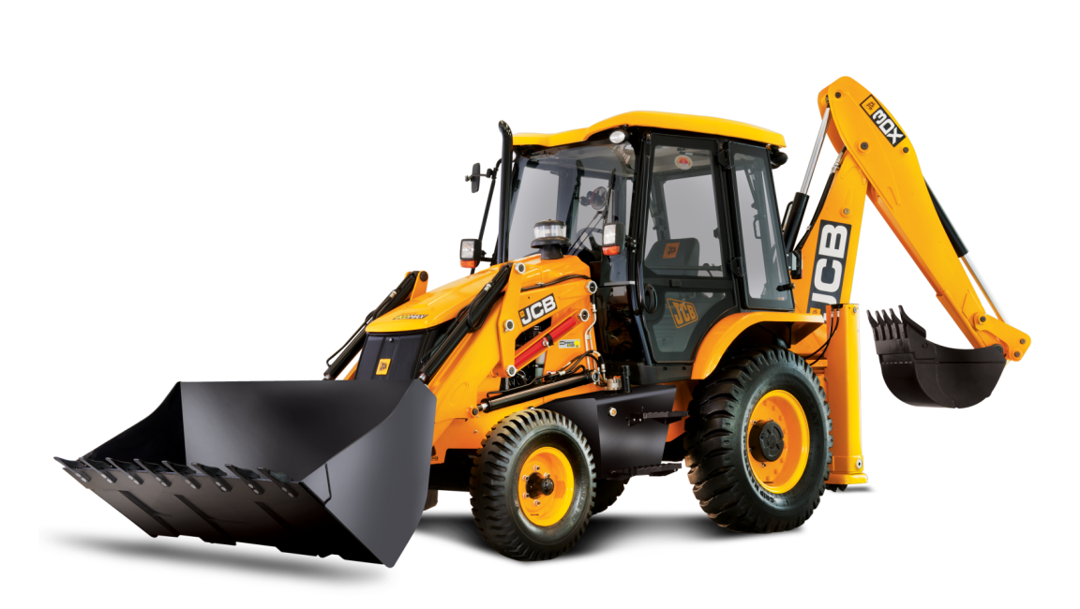
Largest backhoe factory in the world
JCB India
Notes:
7
7
In 2009 JCB also opened the largest backhoe loader factory in the world – in New Delhi, India

Slide 8
A tool for Every Job

Slide 9
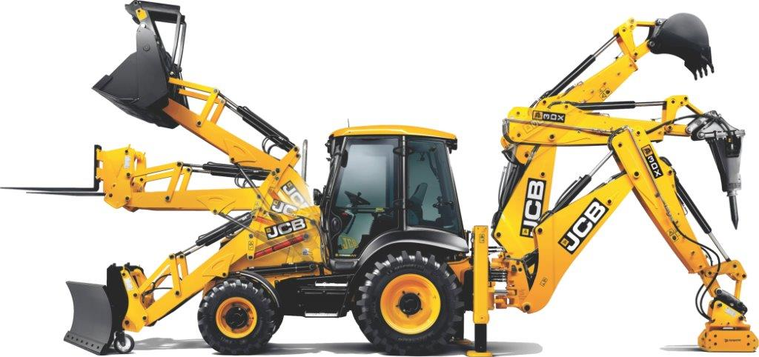
Versatility through JCB BHL

Slide 10
Rural development and wealth creation
1
Infrastructure
2
Healthcare
3
Education
Notes:
Rural populations need, infrastructure, education and healthcare, by providing these basic rural development flourishes.

Slide 11
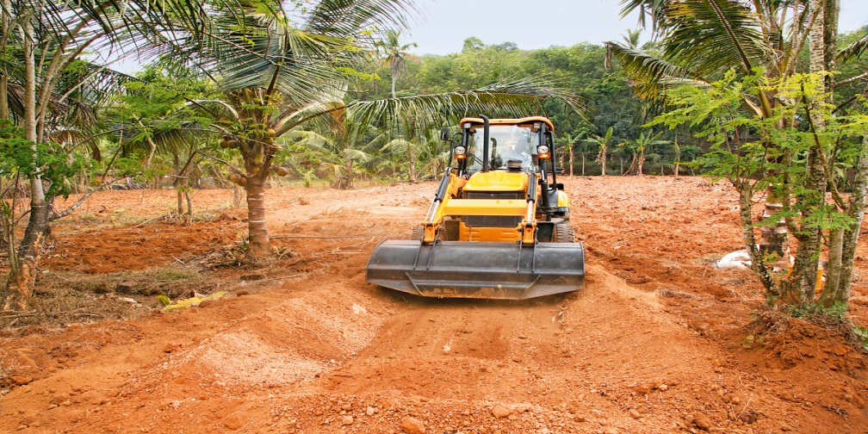
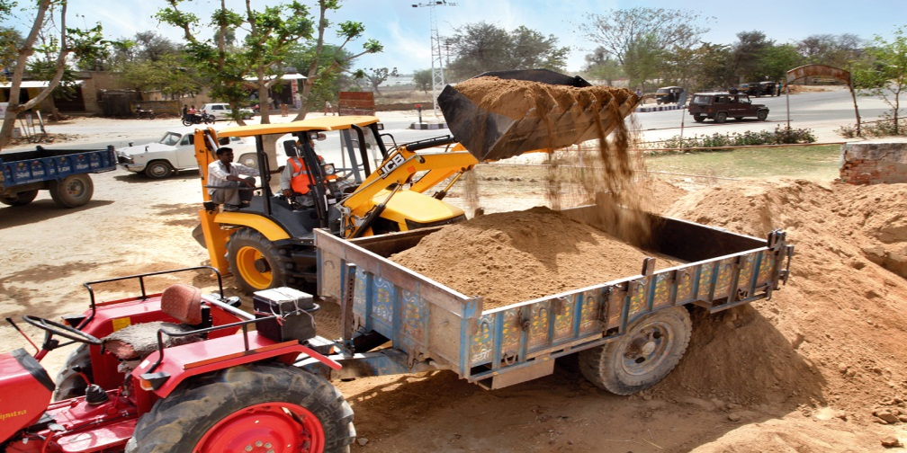
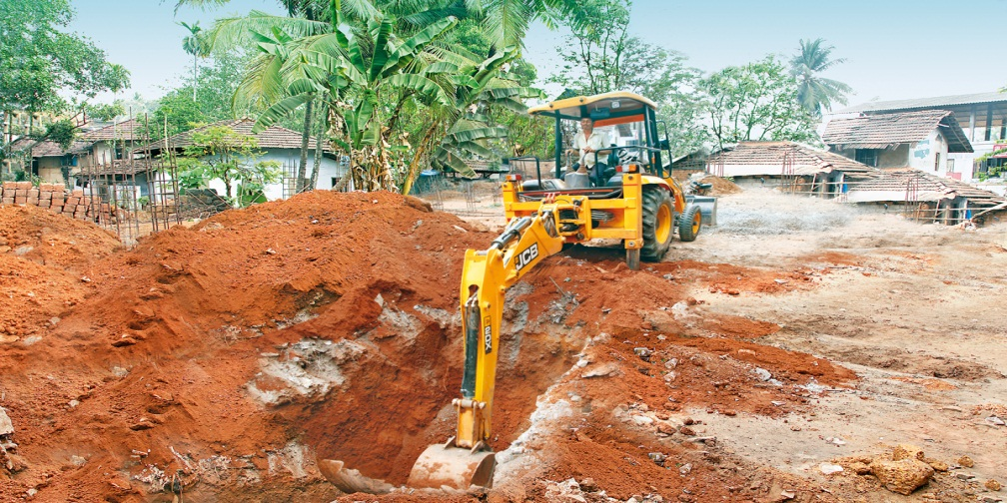
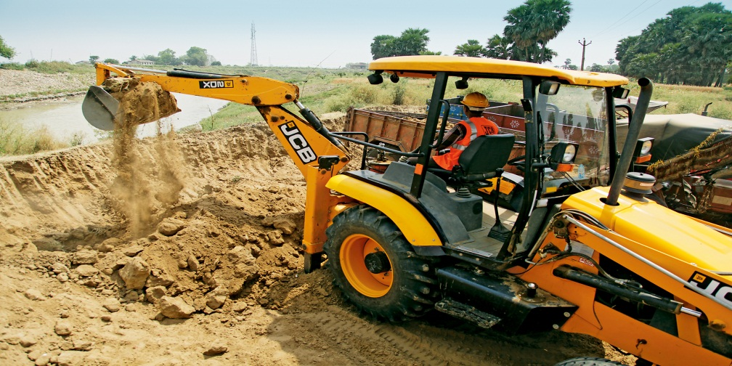

Slide 12
Brazil’s Ministry of Agrarian Development
$120m
2,000 machines
Notes:
A similar story can be seen in Brazil where JCB recently secured a $120m supply contract for 2000 of these machines to the Ministry of Agrarian Development.

Slide 13
Rural to urban relocation
Notes:
The country has recognised that the recent trend of rural to urban relocation cannot continue…

Slide 14
Choked cities
Notes:
and their major cities begin to choke…

Slide 15
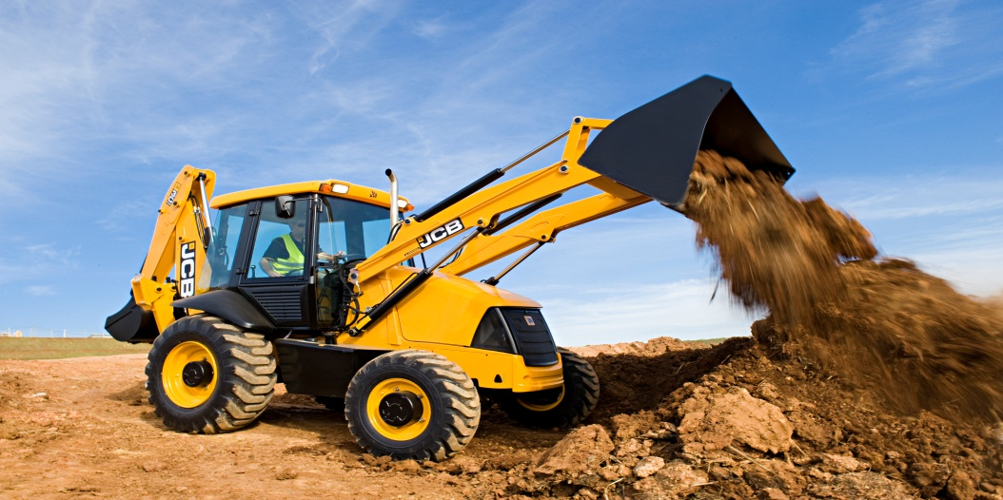
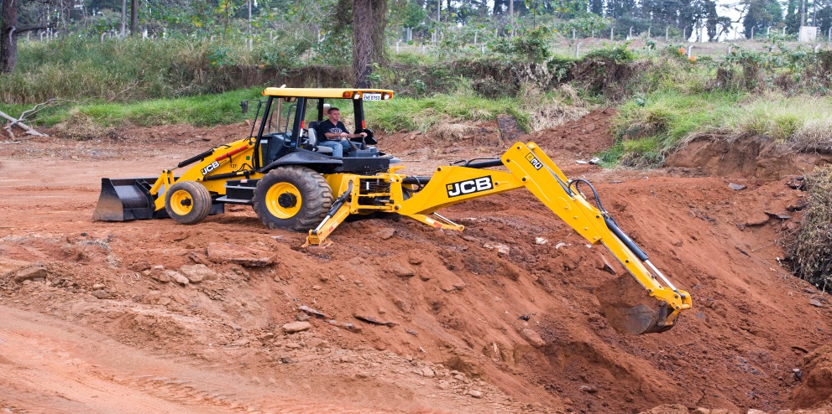
Rural Infrastructure Development is KEY!
Notes:
means that rural infrastructure development is key in enabling shared sustainable growth.

Slide 16
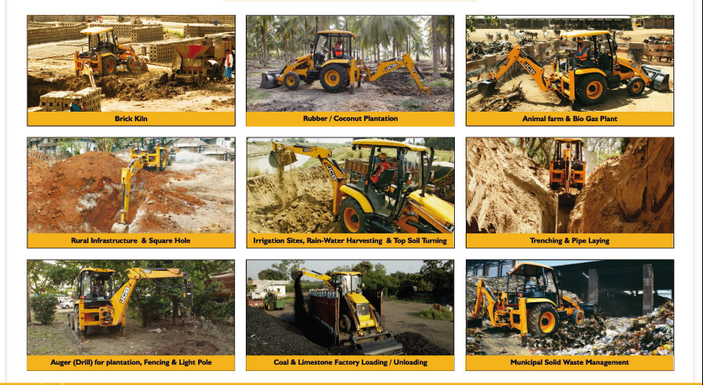
Rural development

Slide 17
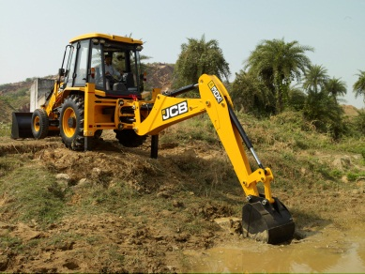
a
r

Slide 18
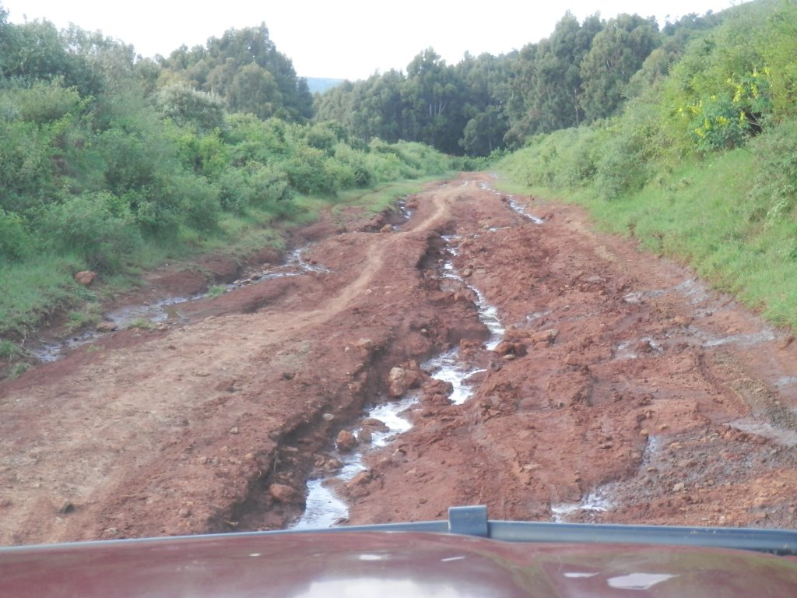
Notes:
means that rural infrastructure development is key in enabling shared sustainable growth.

Slide 19
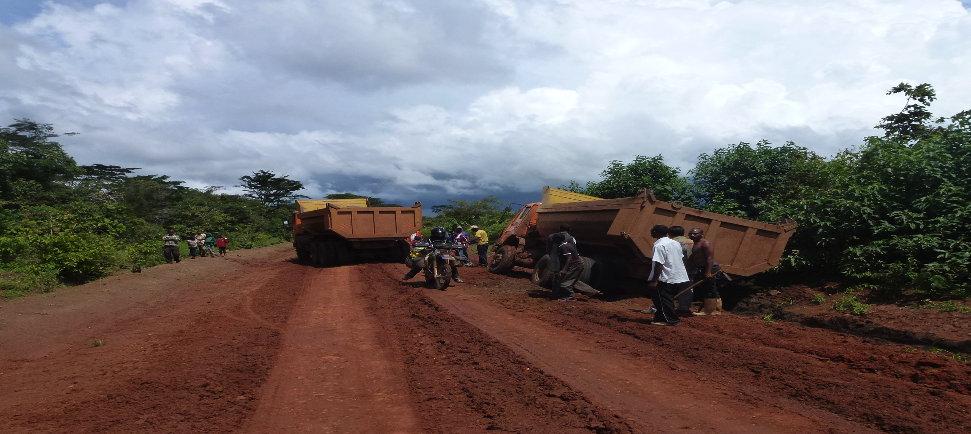
Notes:
means that rural infrastructure development is key in enabling shared sustainable growth.

Slide 20
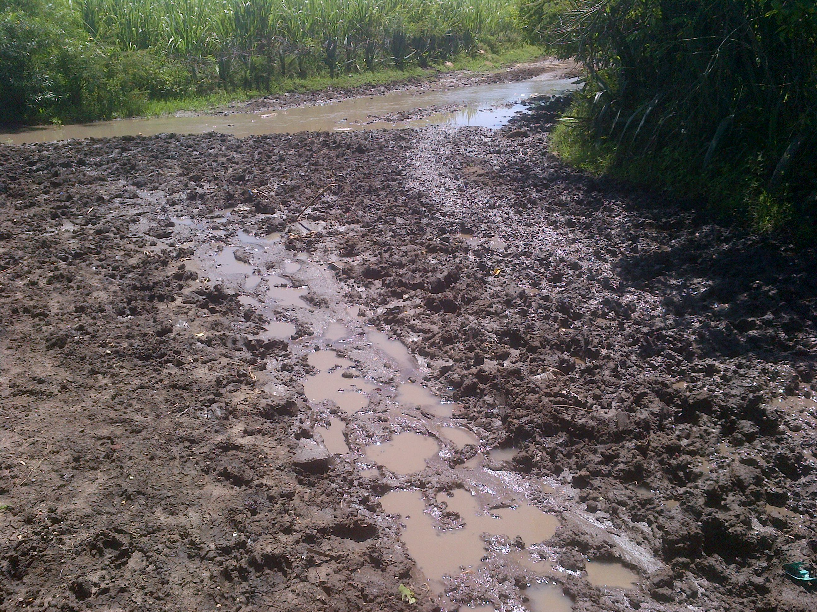
Notes:
means that rural infrastructure development is key in enabling shared sustainable growth.

Slide 21
Notes:
means that rural infrastructure development is key in enabling shared sustainable growth.

Slide 22
“Rural roads are found to have greater economic impact than any other investment - before education, agriculture and health in India, Thailand, China, Ethiopia and Uganda”
Maryvonne Plessis-Fraissard
Former Director for Transport and Urban Development – World Bank

